Slide 1
Cultivating Well-Being at Georgia Tech

Slide 2
What’s in the pond at Georgia Tech?
“If the frogs in a pond started behaving strangely, our first reaction would not be to punish them or even treat them. Instinctively, we’d wonder what was going on in the pond.”
Attributed to Dan Reist, University of Victoria Canadian Institute for Substance Use Research
Notes:
This slide frames the scope of Cultivate Well-Being Action & Transformation. The role of this collective movement is to address the institutional culture around well-being. In this example, Tech community members are the "frogs" and Tech culture is the "pond". This is an example of a settings-based approach to public health. Rather than trying to improve individual wellness one person/frog at a time, we are taking an expansive look at the systems, policies, practices/ pond that impact well-being for everyone in the Tech community.

Slide 3
Changing the Culture at Georgia Tech
We can impact and influence the context, climates and correlates that are known to be associated with higher levels of well-being
Our work focuses on creating the conditions for cultivating well-being so community members can thrive
Culture change is a long-term endeavor.
Notes:
This slide describes what we do as Cultivate Well-Being Action & Transformation: Changing the culture around well-being and influencing the context, climates, and correlates that are linked with higher level of well-being.

Slide 4
Big Bets
Foundational Priorities
Be a national leader in outcomes and value for all students.
Double the number of degrees granted and non-degree learners.
Double the scale and amplify the impact of our research.
Build a national hub for innovation, creativity, and entrepreneurship.
5. Promote the well-being of all members of the Georgia Tech community.
6. Build a model, sustainable campus that inspires and supports the well- being of people across the Institute and surrounding communities.
7. Improve campus services and processes to enhance the Georgia Tech experience for all.
8. Develop the full competitive potential of Georgia Tech Athletics.
Georgia Tech Strategic Plan
Notes:
Highlighting the Institute Strategic Plan and Foundational Priority 5 will help frame our why. Well-being is foundational to our success in reaching these goals as it underpins student success, faculty and staff output

Slide 5
Foundational Priority 5
Promote the well-being and protect the freedom of expression of all members of the Georgia Tech community.
5.1: Increase freedom of expression and the intellectual vitality reported by people of all backgrounds and perspectives across our community.
5.2: Increase the engagement, well-being, and sense of belonging reported by our students, faculty, staff and community members of all backgrounds.
GT Strategic Plan Foundational Priorities
Notes:
Highlighting the Institute Strategic Plan and Foundational Priority 5 will help frame our why. Foundational Priority 1 focuses on freedom of expression to foster the exchange of ideas as well as engagement, well-being, and sense of belonging to foster an environment where everyone from all backgrounds are included.

Slide 6
Cultivating well-being requires collective action
Social and cultural transformation, of the kind necessary to improve wellness outcomes over time in a large, complex organization like Georgia Tech, cannot be achieved through the isolated impact of individual units or cabinet areas.
All people in all units have a role to play in cultivating well-being for the Tech community.
Notes:
Action steps can be found online at wellbeing roadmaps.gatech.edu.

Slide 7
Well-Being Roadmaps for Students, Faculty and Staff
Goals of the Roadmap
Cultural Change
Catalyze cultural change by expanding the aspects of our culture that contribute to well-being and minimizing aspects that don’t.
Capacity and Creativity
Continue to improve quality of and access to primary prevention, health promotion, and conditions that sustain well-being.
Title Goes Here
Community and Connection
Increase awareness of and access to engagement experiences at Tech that contribute to factors that comprise well-being.
Commitment and Continuity
Incorporate an action framework for higher education into Tech’s ongoing administration, operations, and culture for the foreseeable future.
Scan the QR code to learn more about the well-being roadmaps and how our office is working to achieve large-scale, collective, place-based change to enhance well-being at Georgia Tech.
Notes:
By implementing the strategies in the Roadmaps, we will enhance the institutional attributes that promote promote health and mitigate the elements of campus culture that have a negative impact on well-being.

Slide 8
Our progress
Implementing the action strategies in the Roadmaps involves tackling some of higher education's most complex challenges. Our cross-unit project teams are exploring and improving:
Accessible mental health systems
Healthy and affordable dining
Effective primary prevention as well as wellness programs and services
Reducing health disparities
Providing for students' basic needs
Amplifying the positive impact of arts, belonging and community on well-being
Curious about our findings? Check out:
Shared Learning – Well-Being Roadmaps

Slide 9
Notes:
We are united by our shared humanity, regardless of academic discipline. major, or job title.

Slide 10
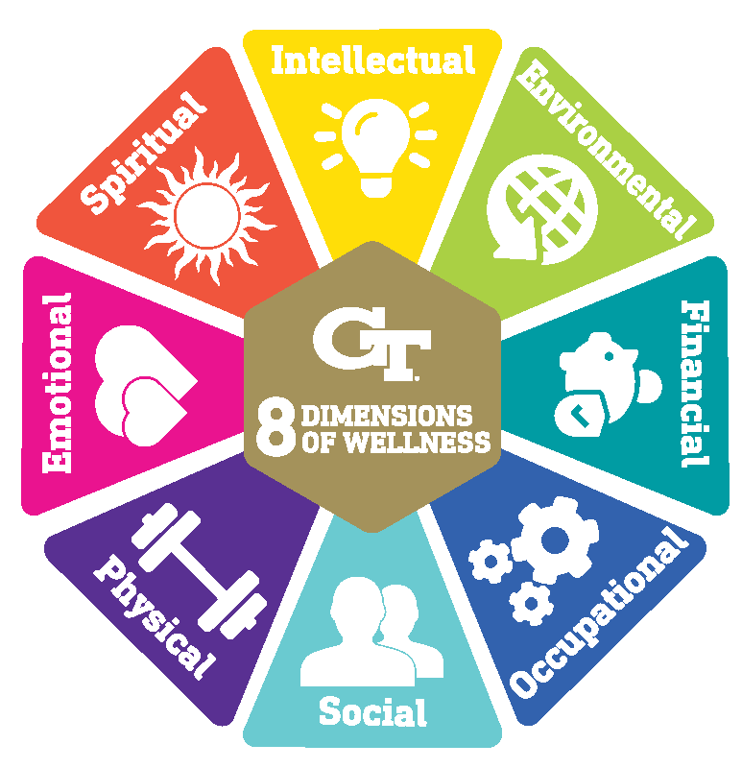
Wellness
Contains multidimensional areas of personal health
Tech uses the 8 Dimensions of Wellness model
Wellness is central to the concept of well-being
Notes:
Wellness: Often contains multidimensional areas of personal health. At Tech, we use 8 dimensions of wellness to holistically think about our personal wellness. The 8 Dimensions of Wellness are emotional, environmental, financial, intellectual, occupational, physical, social, and spiritual. Wellness is central to the concept of well-being but is only a piece of the broader system.

Slide 11
Well-Being
Person
Place
Planet
The individual health and wellness of a person and groups of people
The conditions and attributes of where we live, learn, work, or play
The conditions and attributes of the physical world we live in
Well-Being moves beyond the level of the individual to encompass the interconnectedness of person, place and planet.
Notes:
Well-being includes the following:
Your personal health and wellness → Person
Also, the conditions and attributes of where we live, play, or work → Place
As well as the conditions and attributes of the physical world we live in → Planet

Slide 12
Health Promoting Colleges and Universities
Health promoting universities and colleges infuse health into everyday operations, business practices, and academic mandates. By doing so, they:
Enhance the success of institutions
Create campus cultures of compassion, well-being, equity, and social justice
Improve the health of the people who live, learn, work, and play on our campuses
Strengthen the ecological, social, and economic sustainability of our communities
Notes:
Tech is part of a national network of health promoting colleges and universities. Our membership allows us to connect with other Institutions of Higher Education to ensure we pursue the healthiest policies, procedures, and practices for the well-being of our students, faculty, and staff.

Slide 13
The Okanagan Charter
An international charter for health promoting universities and colleges with two calls to action
Embedding health into all aspects of campus culture, across the administration, operations, and academic mandates
Lead health promotion action and collaboration locally and globally
Notes:
The Okanagan Charter is a document that many universities draw guidance from in their health promotion efforts. More information about the Okanagan Charter can be found here: http://ushpcn.org/okanagan-charter/ One of the recommendations in the Cultivate Well-Being Roadmaps at Tech is to explore whether there is a desire to adopt the Okanagan Charter to guide our work in the future.

Slide 14
Discussion

Slide 15
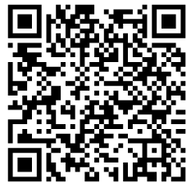
Discussion Questions
How does Tech create conditions in which students, staff and faculty can be healthy?
How could Tech better create conditions in which students, staff and faculty can be healthy?
What aspects of campus culture, including policies and practices, have the most benefit to well-being?
What policies or practices should be discontinued to remove barriers to well-being?
Answer anonymously online by scanning this QR code with your phone.

Slide 16
Q & A

Slide 17
For more information
Please contact the Office of Cultivate Well-Being Action & Transformation.
Heather Zesiger, PhD, MPH, MCHES
Director
Malcolm Robinson
Project Support Specialist, Sr.

